Slide 1
Virtualization
Brijendra Singh

Slide 2
Virtualization
Technology that you can use to create virtual representations of servers, storage, networks, and other physical machines.
Virtual software mimics the functions of physical hardware to run multiple virtual machines simultaneously on a single physical machine.
Businesses use virtualization to use their hardware resources efficiently and get greater returns from their investment.
It also powers cloud computing services that help organizations manage infrastructure more efficiently.

Slide 3
Why is virtualization important?
You can interact with any hardware resource with greater flexibility.
Physical servers consume electricity, take up storage space, and need maintenance. You are often limited by physical proximity and network design if you want to access them.
Virtualization removes all these limitations by abstracting physical hardware functionality into software.
You can manage, maintain, and use your hardware infrastructure like an application on the web.

Slide 4
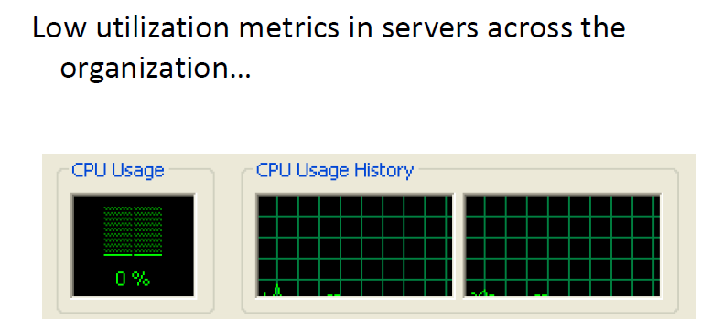
Why virtualization?
Too many servers for too little work
Aging hardware reaching end of usable life
High infrastructure requirements
Limited flexibility in shared environments

Slide 5
Virtualization example
Consider a company that needs servers for three functions:
(i) Store business email securely
(ii) Run a customer-facing application
(iii) Run internal business applications
Each of these functions has different configuration requirements:
The email application requires more storage capacity and a Windows operating system.
The customer-facing application requires a Linux operating system and high processing power to handle large volumes of website traffic.
The internal business application requires iOS and more internal memory (RAM).

Slide 6
Virtualization example
To meet these requirements, the company sets up three different dedicated physical servers for each application.
The company must make a high initial investment and perform ongoing maintenance and upgrades for one machine at a time.
The company also cannot optimize its computing capacity. It pays 100% of the servers’ maintenance costs but uses only a fraction of their storage and processing capacities.

Slide 7
Virtualization example
Efficient hardware use
With virtualization, the company creates three digital servers, or virtual machines, on a single physical server. It specifies the operating system requirements for the virtual machines and can use them like the physical servers. However, the company now has less hardware and fewer related expenses.
Infrastructure as a service
The company can go one step further and use a cloud instance or virtual machine from a cloud computing provider such as AWS. AWS manages all the underlying hardware, and the company can request server resources with varying configurations. All the applications run on these virtual servers without the users noticing any difference. Server management also becomes easier for the company’s IT team.

Slide 8
What is virtualization?
Virtualization is a process that allows a computer to share its hardware resources with multiple digitally separated environments.
Each virtualized environment runs within its allocated resources, such as memory, processing power, and storage.
With virtualization, organizations can switch between different operating systems on the same server without rebooting.
Virtual machines and hypervisors are two important concepts in virtualization.

Slide 9
Virtual machine
A virtual machine is a software-defined computer that runs on a physical computer with a separate operating system and computing resources. The physical computer is called the host machine and virtual machines are guest machines. Multiple virtual machines can run on a single physical machine. Virtual machines are abstracted from the computer hardware by a hypervisor.
Hypervisor
The hypervisor is a software component that manages multiple virtual machines in a computer. It ensures that each virtual machine gets the allocated resources and does not interfere with the operation of other virtual machines. There are two types of hypervisors.
Type 1 hypervisor
A type 1 hypervisor, or bare-metal hypervisor, is a hypervisor program installed directly on the computer’s hardware instead of the operating system. Therefore, type 1 hypervisors have better performance and are commonly used by enterprise applications. KVM uses the type 1 hypervisor to host multiple virtual machines on the Linux operating system.
Type 2 hypervisor
Also known as a hosted hypervisor, the type 2 hypervisor is installed on an operating system. Type 2 hypervisors are suitable for end-user computing.

Slide 10
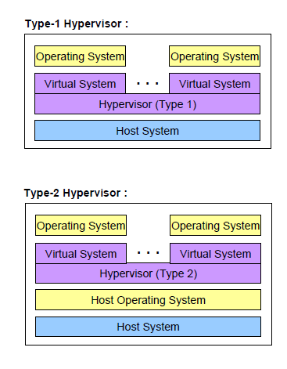

Slide 11
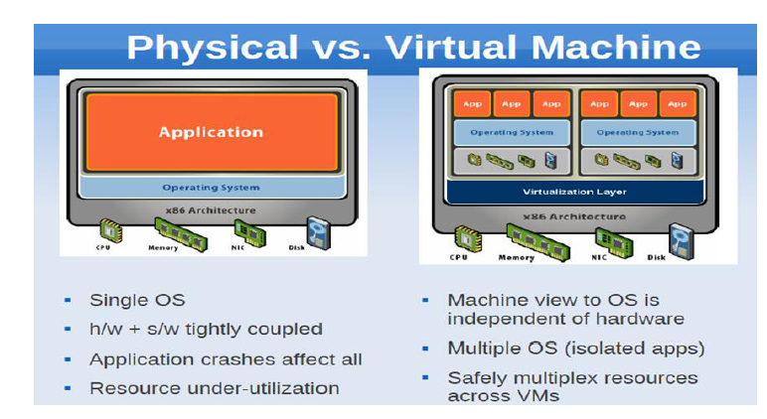
Comparison

Slide 12
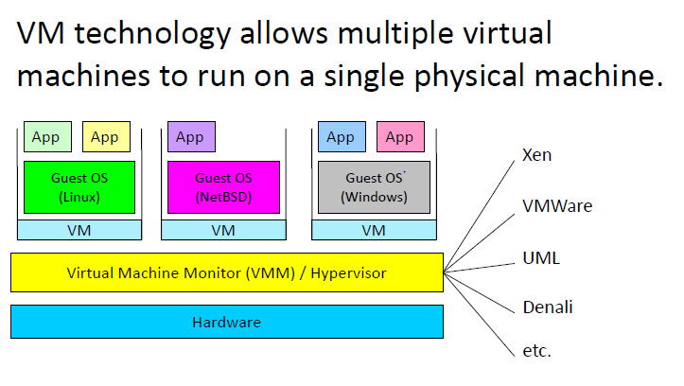
Virtual Machine

Slide 13
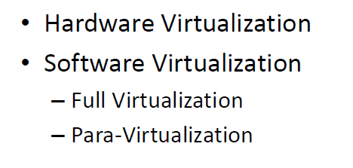
Approaches to Virtualization

Slide 14
Hardware virtualization is the method used to create virtual versions of physical desktops and hardware resources.
Para-virtualization, an approach to virtualization is designed to allow multiple operating systems to run on a single computer at the same time. Of course, the virtualization mechanism can not allow a given operating system to take over the underlying hardware completely.
Instead, para-virtualization uses a piece of software known as a hypervisor to control multiple operating systems and move the processors among them analogous to the way a single operating system moves the processor among a set of running processes.

Slide 15
To prohibit a given operating system from commandeering the hardware, para- virtualization requires the code for an operating system to be altered before it can be used.
Examples of para virtualization are Microsoft Hyper-V, Citrix Xen, etc.
Full virtualization
Like para-virtualization, the approach known as full virtualization allows multiple operating systems to run on the same computer at the same time. Furthermore, full virtualization allows operating system code to run unaltered.
Examples of full virtualization are Microsoft and Parallels systems.

Slide 16
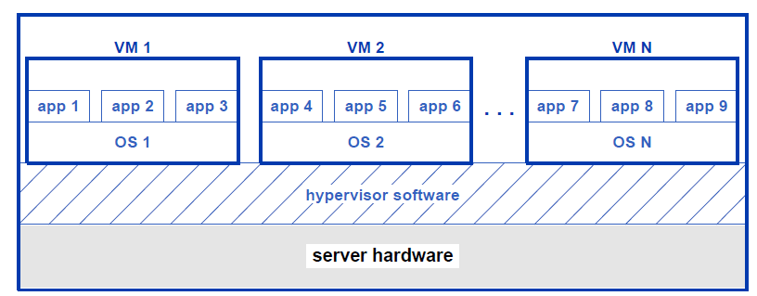
Conceptual organization of VM systems

Slide 17
Conceptual organization of VM systems
The general idea behind VM is straightforward: load software onto a server that allows the cloud provider to create one or more VMs.
Allow the tenant who owns each VM to boot an operating system on the VM, and then use the operating system to launch one or more applications.
The key piece of software responsible for creating and managing VMs is known as a hypervisor. We think of a hypervisor as controlling the underlying hardware.
Each VM the hypervisor creates is independent of other VMs

Slide 18
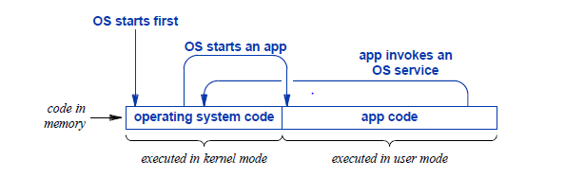
Illustration of operating system and app code in memory.
The processor executes each at the same high speed, changing mode when transitioning from one to the other.

Slide 19
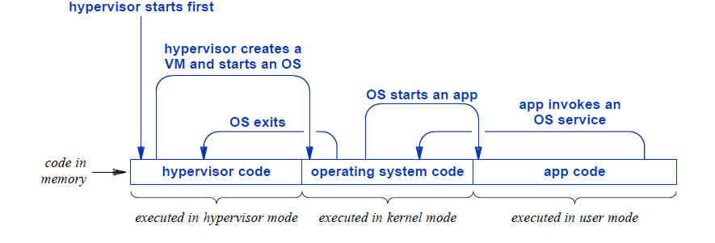
Extending Privilege To A Hypervisor
Three levels of privilege: one for the hypervisor, a second for an operating system, and a third for apps.
Only the hypervisor can create a VM and allocate memory to the VM.
The operating system is restricted to the memory that has been allocated to its VM.

Slide 20
Different types of Virtualization
Server virtualization is a process that partitions a physical server into multiple virtual servers.
It is an efficient and cost-effective way to use server resources and deploy IT services in an organization.
Without server virtualization, physical servers use only a small amount of their processing capacities, which leave devices idle.

Slide 21
Storage virtualization
Storage virtualization combines the functions of physical storage devices such as network attached storage (NAS) and storage area network (SAN).
You can pool the storage hardware in your data center, even if it is from different vendors or of different types.
Storage virtualization uses all your physical data storage and creates a large unit of virtual storage that you can assign and control by using management software.
IT administrators can streamline storage activities, such as archiving, backup, and recovery, because they can combine multiple network storage devices virtually into a single storage device.

Slide 22
Network Virtualization
Any computer network has hardware elements such as switches, routers, and firewalls.
An organization with offices in multiple geographic locations can have several different network technologies working together to create its enterprise network.
Network virtualization is a process that combines all of these network resources to centralize administrative tasks.
Administrators can adjust and control these elements virtually without touching the physical components, which greatly simplifies network management.

Slide 23
Data Virtualization
Modern organizations collect data from several sources and store it in different formats.
They might also store data in different places, such as in a cloud infrastructure and an on-premises data center.
Data virtualization creates a software layer between this data and the applications that need it.
Data virtualization tools process an application’s data request and return results in a suitable format.
Thus, organizations use data virtualization solutions to increase flexibility for data integration and support cross-functional data analysis.

Slide 24
Application Virtualization
Application virtualization pulls out the functions of applications to run on operating systems other than the operating systems for which they were designed.
For example, users can run a Microsoft Windows application on a Linux machine without changing the machine configuration. To achieve application virtualization, follow these practices:
Application streaming – Users stream the application from a remote server, so it runs only on the end user's device when needed.
Server-based application virtualization – Users can access the remote application from their browser or client interface without installing it.
Local application virtualization – The application code is shipped with its own environment to run on all operating systems without changes.

Slide 25
Desktop Virtualization
Most organizations have non technical staff that use desktop operating systems to run common business applications.
For instance, you might have the following staff:
A customer service team that requires a desktop computer with Windows 10 and customer-relationship management software
A marketing team that requires Windows Vista for sales applications
You can use desktop virtualization to run these different desktop operating systems on virtual machines, which your teams can access remotely.
This type of virtualization makes desktop management efficient and secure, saving money on desktop hardware.

Slide 26
Desktop Virtualization
The following are types of desktop virtualization.
Virtual desktop infrastructure
Virtual desktop infrastructure runs virtual desktops on a remote server. Users can access them by using client devices.
Local desktop virtualization
In local desktop virtualization, you run the hypervisor on a local computer and create a virtual computer with a different operating system.
You can switch between your local and virtual environment in the same way you can switch between applications.

Slide 27
How is virtualization different from cloud computing?
Cloud computing is the on-demand delivery of computing resources over the internet with pay-as-you-go pricing. Instead of buying, owning, and maintaining a physical data center, you can access technology services, such as computing power, storage, and databases, as you need them from a cloud provider.
Virtualization technology makes cloud computing possible. Cloud providers set up and maintain their own data centers. They create different virtual environments that use the underlying hardware resources. You can then program your system to access these cloud resources by using APIs. Your infrastructure needs can be met as a fully managed service.

Slide 28
How is server virtualization different from containerization?
Containerization is a way to deploy application code to run on any physical or virtual environment without changes. Developers bundle application code with related libraries, configuration files, and other dependencies that the code needs to run. This single package of the software, called a container, can run independently on any platform. Containerization is a type of application virtualization.
You can think of server virtualization as building a road to connect two places. You have to recreate an entire virtual environment and then run your application on it. By comparison, containerization is like building a helicopter that can fly to either of those places. Your application is inside a container and can run on all types of physical or virtual environments.

Slide 29
VM As A Digital Object
A VM differs from a real server in a significant way: a VM is created and managed entirely by software(Hypervisor).
A hypervisor must keep a record of the VM, the region(s) of memory that have been allocated to the VM, the virtual I/O devices that have been created for the VM (including disk space that has been allocated in the data center storage facility), and the current status of the VM (e.g., whether the VM is currently running or has been suspended to allow another VM to run).
Because a VM is implemented with software, all the pieces of a VM can be collected together into a digital object.

Slide 30
VM As A Digital Object
Having a complete record of each VM in a hypervisor has an interesting consequence: a VM can be turned into a digital object.
That is, the entire VM can be transformed into a set of bytes.
To understand how, imagine that a VM is currently suspended. The hypervisor has a record of all the memory the VM is using, so the VM’s memory segments can be collected.
Imagine, for example, that they are placed in a special file. The code and data for the operating system and apps that the VM is running are all stored in memory, so when the VM’s memory has been collected, the OS and apps will be collected.
Similarly, the virtual devices that have been created for the VM consist of software, so they can be collected as well.

Slide 31
VM Migration
The ability to collect all the pieces of a VM into a digital object has great significance, and data centers take advantage of it.
Suppose, for example, that a data center manager receives an alert that a power supply is about to fail on a server. The manager can instruct the hypervisor to stop all the VMs running on the server, save a copy of each VM on disk, and then shut the server down.
The manager can replace the server hardware, reboot the server, reload all the VMs, and resume operating, allowing each of them to continue where it left off.

Slide 32
VM Migration
Although it allows one to stop and restart a server, the ability to convert a VM to a digital object enables something much more important in cloud data centers: VM migration. That is, a VM can be moved.
The basic idea is straightforward: stop a VM that is running on one server, convert the VM to a digital object, send the bytes across the network to a new server, and resume the VM on the new server.
That is, a hypervisor on one server converts a VM into a digital object, sends the object to the hypervisor on another server, and the receiving hypervisor resumes the VM on its server. Although the VM is moved and the hypervisors do the work, the cloud industry says the VM migrates from one server to another.

Slide 33
VM Migration
The ability to migrate VMs allows a provider to rebalance loads dynamically.
Suppose, for example, that the VMs running on server X all perform intensive long-running computations with little or no I/O activity. Further suppose that the VMs running on server Y transfer huge amounts of data, but do not spend much time on computing.
The processor on server X will be saturated while the processor on server Y will remain relatively idle. Meanwhile, the I/O bus on server Y will be saturated while the bus on X is relatively idle. Migration allows a data center owner to balance the two servers by moving some of the VMs from Y to X and some of the VMs originally on X to Y.
As a result, neither server will have a saturated processor or a saturated I/O bus.

Slide 34
Conflicting Goals For A Data Center Network
Interestingly, data center network designers face a challenge of balancing between two conflicting goals:
Universal connectivity
Safe, isolated communication
On the one hand, to permit VMs and containers to communicate between arbitrary physical servers, a data center network must provide universal connectivity. On the other hand, a given tenant seeks a network architecture that keeps their VMs and containers isolated and safe.
Notes:
Difference between VM and containers?
VM provide abstracted version of entire hardware of physical machine. Containers are portable instances of software that runs on a physical or virtual machine.

Slide 35
Virtual Networks, Overlays, And Underlays
Conceptually, each virtual network links a tenant’s virtual machines and containers. Next Figure illustrates the idea by showing two virtual networks that each link four VMs. Keep in mind that the two networks in the figure are fiction. In reality, each VM runs on a server in a rack, and racks are connected by spine switches. Suppose, for example, that VM 2 and VM 5 run on servers in separate racks. The network path between them includes two leaf switches and at least a spine switch.

Slide 36
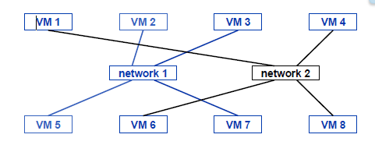
Illustration of two virtual networks that each connect four VMs. Each virtual network forms an overlay.
The term overlay network refers to a virtual network created by configuring switches, and the term underlay network refers to the underlying physical network that provides actual network connections.

Slide 37
VLAN technology
VLAN technology imposes a set of virtual overlay networks on a set of switches, and each computer attached to the switches is assigned to one of the virtual networks.
The technology does not solve the problem of separate virtual networks for tenants in a large data center.

Slide 38
Scaling VLANs To A Data Center With VXLAN
Engineers extended VLAN technology to a scale sufficient for the largest data centers. They devised a technology known as Virtual Extensible LAN (VXLAN) that many data centers use.
The technology requires each switch to include VXLAN software, and requires the network administrator to configure special routing protocols so the VXLAN system can learn the locations of computers in the datacenter. Once it has been configured, VXLAN can provide the equivalent of more than sixteen million virtual networks — enough for even the largest cloud providers.
VXLANs help network admins overcome the challenges of VLANs, such as: Scaling limitations for network segmentation and isolation.

Slide 39
Network Address Translation (NAT)
Recall that container technology allows an app to run in a separate environment, isolated and protected from other containers. The question arises, does each container have its own IP address, or do containers all share the IP address of the host OS? The answer is that container technology supports three possibilities:
A container can clone the host’s IP address
A container can receive a new IP address
A container can use address translation

Slide 40
A container can clone the host’s IP address.
If a container uses the same IP address as the hostOS, we say that the container has cloned the address. Using the same address as the host OS means the container’s network use may conflict with the use by normal apps or other containers that have cloned the address.
For example, if two containers clone the host’s IP address and both attempt to run a web server on port80, only the first request will be succeed. Consequently, cloning is seldom used in a cloud data center.

Slide 41
A container can receive a new IP address.
Each container can be assigned a unique IP address, and the host operating system can use a virtual switch to provide connectivity.

Slide 42
A container can use address translation.
Address translation was invented and widely deployed before cloud computing arose.
Infact, many individuals have used NAT technology either from a wireless router in their residence or a Wi-Fi hotspot, such as those in coffee shops and hotels, known by the acronym NAT (Network Address Translation), the technology allows multiple computers to share a single IP address.

Slide 43
A container can use address translation.
When used with containers, NAT software runs in the host operating system.
When a container that uses NAT begins execution, the container requests an IP address, and the NAT software responds to the request by assigning an IP address from a set of reserved, private IP addresses that can not be used on the Internet.
How can a container with a private address communicate with computers on the Internet?

Slide 44
A container can use address translation.
The NAT software handles communication by intercepting each outgoing packet and replacing the private IP address with the IP address of the host OS.
NAT then sends the packet. When a reply comes back, NAT replaces the host’s address with the private address assigned to the container, and forwards the reply to the container.
NAT allows multiple containers to share the host’s IP address safely analogous to the way a wireless router or Wi-Fi hotspot allows multiple devices to share an IP address.

Slide 45
Managing Virtualization And Mobility
Configuring and managing the network in a cloud data center poses a complex challenge for three reasons:
Complex interconnections among switches
Multiple levels of virtualization
Arbitrary placement of addressable entities and migration

Slide 46
Complex interconnections among switches.
To understand the complexity of a physical network, look at the figure given below.
Imagine configuring each switch to have correct forwarding rules for destinations on the global Internet as well as for each possible destination in the data center. Consider that the configuration in a switch must specify all equal-cost paths for a destination, allowing ECMP(Equal Cost Multi-Path) hardware to balance the load across all the paths.

Slide 47
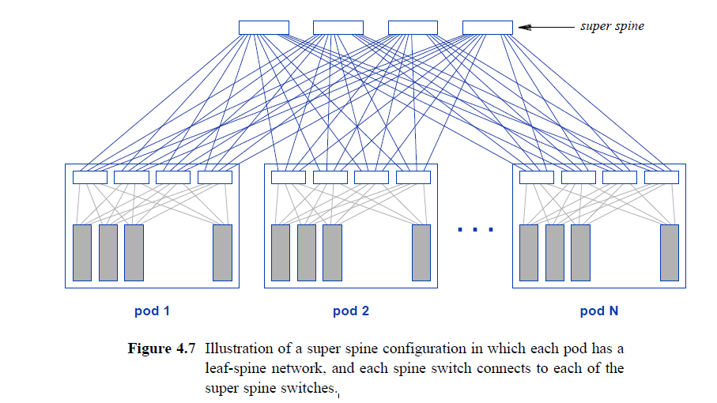

Slide 48
Multiple levels of virtualization
Consider the configuration needed for VXLAN technology. Each switch in the data center must be configured with an IP address, and IP forwarding must be working correctly before VXLAN can be added.
Furthermore, IP multicast must also be configured, and operating correctly because VXLAN uses IP multicast.
In addition, VXLAN requires a manager to configure routing protocols that propagate address information across the entire data center.
Notes:
IP multicast is a method of sending Internet Protocol (IP) datagrams to a group of interested receivers in a single transmission.

Slide 49
Arbitrary placement of addressable entities and migration
A provider can place addressable entities — VMs and containers — on arbitrary physical servers .
As a consequence, the IP addresses that belong to a given tenant may be spread across the data center.
More important, whatever system is used to connect all the virtual entities owned by a tenant must accommodate VM migration, and must update forwarding over the network to allow them to reach one another after a migration.

Slide 50
Software Defined Networking
A technology for automated network management known as Software Defined Networking (SDN) stands out as especially important for data centers.
SDN allows a manager to specify high-level policies†, and uses a computer program to configure and monitor network switches according to the policies.
That is, instead of relying on humans, a data center owner can use software to master the complexity and handle the necessary low-level details.
Software can accommodate a large data center, can handle multiple levels of virtualization, and can update forwarding rules when VMs migrate.

Slide 51
The SDN approach uses a dedicated computer to run SDN software. The computer runs a conventional operating system, typically Linux, an SDN controller app, and a management app(or apps).A management app can use policies to choose how to forward packets.
The controller forms a logical connection to a set of switches and communicates appropriate forwarding rules to each switch.
Next figure illustrates an SDN controller communicating with six switches.

Slide 52
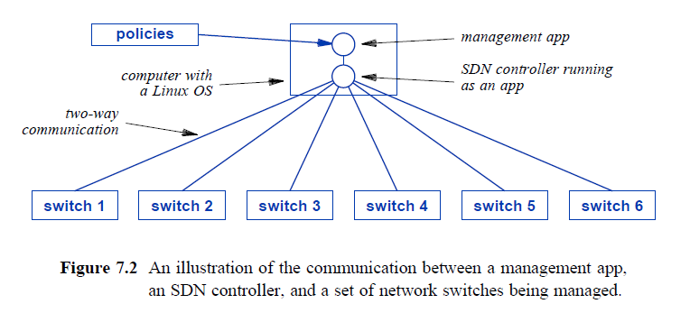

Slide 53
As the figure shows, the logical connections between an SDN controller and each switch employ bidirectional communication that allows data to flow in either direction.
In addition to the controller sending configuration to the switch, the controller can monitor the status of the switch itself and the links to other switches. For example, SDN can configure a switch to inform the controller when events occur, such as link failure or recovery.
Furthermore, a switch can send specified packets to the controller. Typically, a controller configures each switch to send the controller any packet that cannot be handled by its forwarding rules.
Thus, the controller will be informed of exceptions, which can include packets from a new application or packets sent as an attack on the data center.

Slide 54
With a solid reputation as a leading provider of trading, clearing, exchange technology, listing, information, and public company services, Nasdaq looked to virtualization when they needed higher performance, more agility, and scalability.
Though the requirements for higher performance, faster provisioning, and ease of management were important to Nasdaq, their decision to look to Nutanix AHV meant not having to compromise on their stringent security needs.

Slide 55
Case Studies
https://www.vistech.com/a-case-study-in-virtualization/
https://www.techbluesoftware.co.in/case-studies-virtualization
https://www.onx.com/resources/case-studies/datacenter-virtualization-managed-services
https://www.enterprisestorageforum.com/software/virtualization-use-cases/
https://www.networkcomputing.com/data-center-networking/case-study-virtualization-delivers-a-cost-saving-lesson
https://www.linkedin.com/pulse/case-study-eras-tech-implements-virtualization-enhanced-o0pxe

